Slide 1
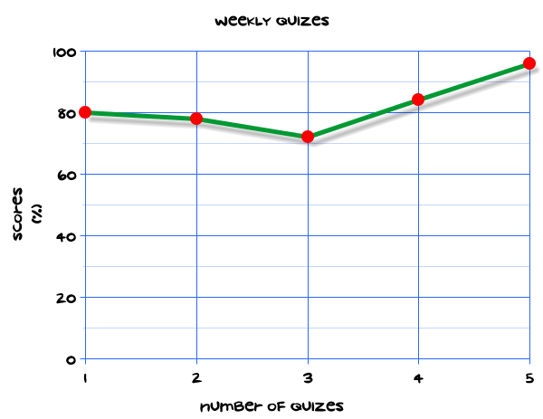
My Statistics Interactive Notebook
Name
Class
Teacher
Term 1 Semester 1
1

Slide 2
Create your own front page
It needs to contain the following –
My number interactive notebook
Name
Class
Teachers Name
Semester 1 Term 1
Page number 1

Slide 3
Contents
Glossary or Formula Page
Page
Date
Description
2
3

Slide 4
Tasks
24
7
30
Essential Question
Questions
Notes
Summary
4
5

Slide 5
24
7
30
Date
Title
EQ –
5

Slide 6
24
7
30
Date
Dot plots
EQ – How do I construct a dot plot?

Slide 7
24
7
30
Date
Dot plots
EQ – How do I construct a dot plot?
What is a dot plot?

Slide 8
24
7
30
Date
Dot plots
EQ – How do I construct a dot plot?
What is a dot plot?
Dot plots are similar to frequency tables. They make it easier to see and interpret data.

Slide 9
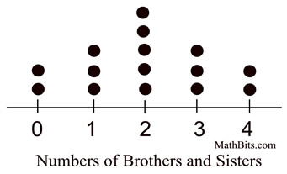
24
7
30
Date
Dot plots
EQ – How do I construct a dot plot?
What is a dot plot?
Dot plots are similar to frequency tables. They make it easier to see and interpret data.

Slide 10
24
7
30
Date
Dot plots
EQ – How do I construct a dot plot?
What is a dot plot?
Dot plots are similar to frequency tables. They make it easier to see and interpret data.
Dots are stacked on top of each other in columns to represent the frequency (or count) of an occurrence.

Slide 11
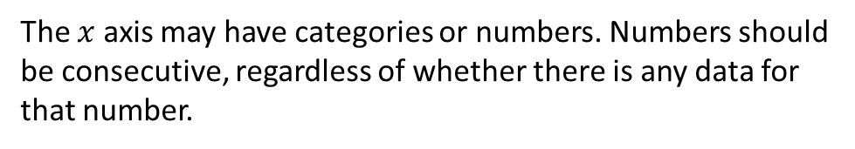
24
7
30
Date
Dot plots
EQ – How do I construct a dot plot?
What is a dot plot?
Dot plots are similar to frequency tables. They make it easier to see and interpret data.
Dots are stacked on top of each other in columns to represent the frequency (or count) of an occurrence.
The $x$ axis may have categories or numbers. Numbers should be consecutive, regardless of whether there is any data for that number.

Slide 12
24
7
30
Date
Dot plots
EQ – How do I construct a dot plot?
What is a dot plot?
Dot plots are similar to frequency tables. They make it easier to see and interpret data.
What do the dots tell me?
Dots are stacked on top of each other in columns to represent the frequency (or count) of an occurrence.
The $x$ axis may have categories or numbers. Numbers should be consecutive, regardless of whether there is any data for that number.

Slide 13

Dot plots: Pros and Cons | Dot plots can be quickly prepared for small amounts of data. They have no need for a frequency axis, and they offer a visual means of comparison. In dot plots, however, you need to count to find the total number of data elements in each stack of dots, and they can be difficult to construct and interpret for data sets with lots of points.

Slide 14
Task
On Monday, students in Year 8 were asked how long it took them to eat their breakfast that morning. The results are shown below:
No. of minutes: 0 1 2 3 4 5 6 7 8 9 10 11 12
No. of students: 6 2 3 5 2 5 0 0 2 3 7 4 1
Construct a dot plot for this data.
What is the mode for this set of data?
What is the median?
Can you find the mean?
What can you say about the number of students who took 0 minutes to eat breakfast?

Slide 15
Notes Review
24, 7 ,30
Date
Title
Essential question
Notes complete
Notes complete with colour and diagrams
Questions completed
Contents page filled in
Formula page filled in

Slide 16
Homework
Review your notes and write a summary answering the essential question.

